Slide 1
Database Record Clean-up
LACONI TSS Presentation
Laura Murff
Director of Technical Services
Lisle Library District
murfl@lislelibrary.org
Notes:
Title slide

Slide 2
LISLE LIBRARY DISTRICT
LLD is a stand alone library district
25+ Full time
20+ Part time
Polaris current ILS
Technical Services
4 Full Time
1 Department Director
2 Librarian - catalogers
1 paraprofessional - acquisitions
2 Part Time
1 30 hr Paraprofessional – serials & copy cataloging
1 25 hr Associate - processing

Slide 3
Why libraries should manage metadata
Notes:
This is a time intensive, never ending project. Staff and patrons will experience the benefit.

Slide 4
Libraries run on databases
Bibliographic records (publications)
Item records (Library owned material)
Authority records (Controlled vocabulary)
Holdings records
Patron records
Notes:
What databases do…
Bilbiographic records tell what type titles we have. Type of material, author, subjects, RDA, Classification info.
Item records tell us where and how many. Changes in collection location, statistical codes, shelf locations
Authority records provide informative and clarifying “sign post” to our collections
Holdings records spell out which specific issues our in our collection. Only carry 1+ current. Local newspaper collections that may change or need updated.
Patron records contain identify charateristics of our users. Gender, Address, Access restrictions like Adult or Child

Slide 5
For the user to…
Find resources
Identify between resources
Select the resource wanted
Obtain access to the resource
Explore more resources

Slide 6
Start small (Its OK we all do)

Slide 7
Known problems
Call number change/update
New/Discontinued collection
Subject heading changes
New Database added
Ad Hoc lists
Staff/Patron reported errors
Mechanical errors
Cognitive errors
Notes:
Many problems are know problems that we have learned to live with. Coding issues in records like diacrites, UTF-8/Unicode create regular expression errors.
Mechanical errors are mostly typos, common slips on the keyboard or dropdown list. For example, our Shelf location list is in alpha order an a common error is coding a item as New Teen when should be Nonfiction.
Cognitive errors are more misunderstanding/misreading text or error based on a lack of knowledge. For example, assigning the wrong call. Come fly the world about being a flight attendant for Pan Am. We have an internal rule that books about a career or business are cataloged in the 33X. Our copy cataloger misunderstood the content of the book.

Slide 8
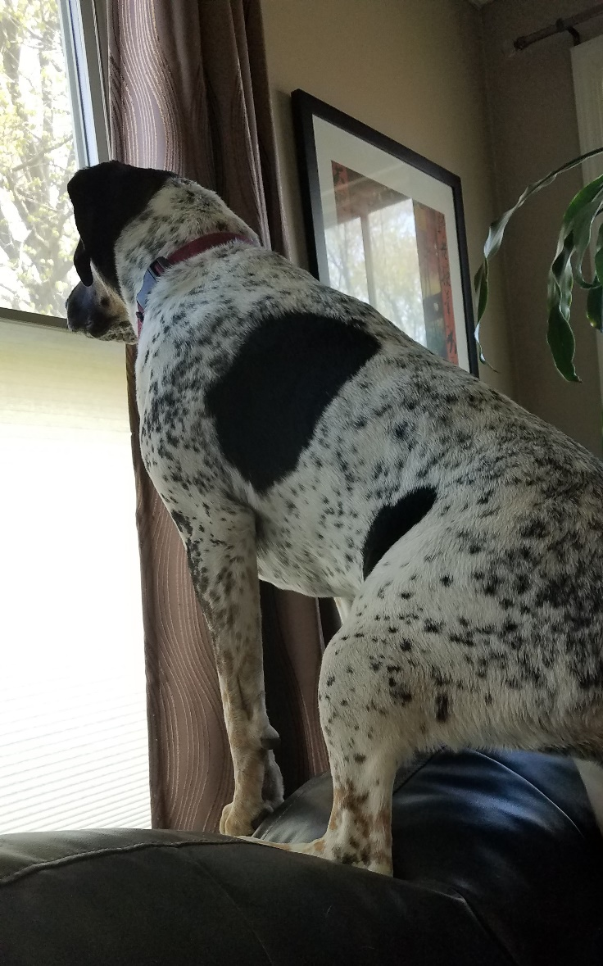
REPORTS AND MORE REPORTS!
Finding Metadata Issues
ILS reports
SSRS (SQL Server Reporting Services)
OCLC worldshare
Merges
Updates
Notes:
ILS -
SSRS (SQL Server Reporting Services) – allows reporting with large datasets from multiply sources
OCLC worldshare
And more!
Types of reports to run:
Duplicate titles
Records with no holdings
Records with no items
Missing fields (ie. 245, 505, 655, etc)
Items not attached to collection, shelf location, statistical code, etc.
Suppressed records
Also find projects through:
Routine workflow
Weeding, deselections, searches
Large scale projects
Migrating ILS

Slide 9
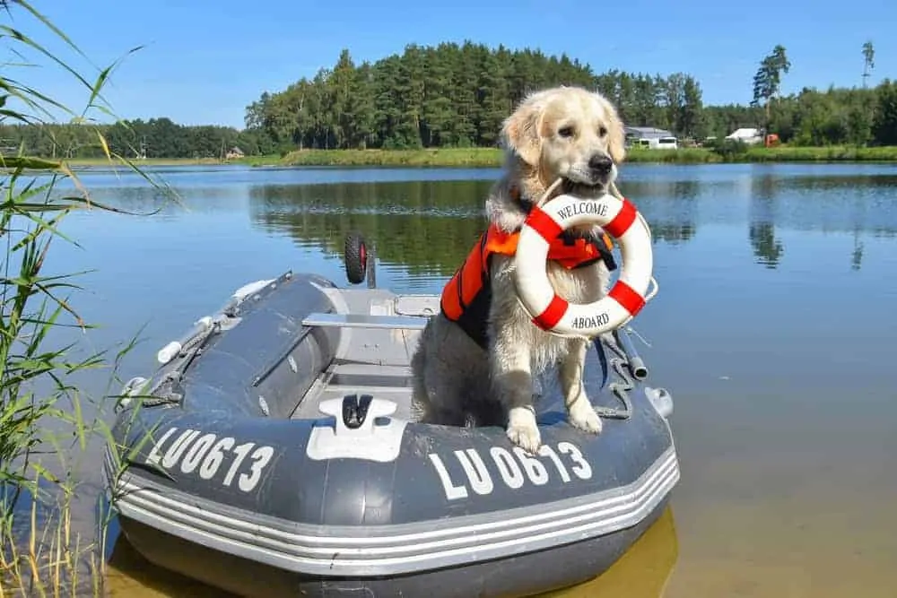
Best Practices
Test
Document
Communication
Schedule
Track
Tools
Notes:
Test make a copy of your data and test out changes before widespread use.
Document choose a documentation method and document all desired outcomes, processes, responsibilities
Communicate with all parties, those working on the project and those effected by the project
Schedule who and what to be done, as well as checkpoints on progress
Track Make sure all work is recorded and progress recorded. Ensures no duplication and smooth movement through process to completion.
Find the appropriate tool for the job. Test and document chosen tools. Ensure access to all.

Slide 10
Documentation
Project name with brief description
Staff members undertaking task
Dates for starting and ending
What has been completed
What needs to be done
Links to external resources
Notes:
Each project is listed in a separate folder with instructions, list, & examples as appropriate.
Develop a new project, one of the staff tests it, writes instructions, and adds it to the master list.
Test end result on test server.
Some work is done manually one-by-one and some globally whenever possible.

Slide 11
Examples of Metadate Maintenance
Call Number Standardization
Brief to Full Record Enhancement
Subject Headings Updates
Record Cleanup
Reading Program Matching
Record De-Duplication
Notes:
Call Number Standardization
Standardize prefixes Call Number Standardization
Standardize prefixes
Truncate dewey numbers
Cutters - choose the character length and
capitalization of the cutter
Record Cleanup
Fix control field errors
Remove unwanted fields
Fix non-filing indicators
Update invalid indicators
Set non-filing indicator for titles
Ensure proper ISBD punctuation
Standardize General Materials Designation (GMD) and/or RDA
control fields for each collection
Brief to Full Record Enhancement
Add missing information such as series information,
summary notes, tables of contents, publication
information or other key search information, when such
information is available in our databases.
Subject Headings Updates
Update outdated subject headings with the latest in
authoritative terminology from:
SEARS LIBRARY OF CONGRESS LC CHILDREN’S
Add childrens subject headings such as adding
Bugs” when finding “Arachnids” or “Cars” when finding
“Automobiles”
Remove unwanted ‘Juvenile’ terminology
Remove redundant subject headings
Arrange the subject heading fields in numerical order
Reading Program Matching
Accurately add reading levels and reading program
information, or remove information if desired.
Lexile®
Accelerated Reader®
Reading Counts®
Fountas & Pinnell®
Record De-Duplication
use several matching points to determine duplicate
records that include LCCN, ISBN, author, title, publisher,
publication date, and pagination.

Slide 12
USEFUL TOOLS
Drive
Slack
Basecamp
Internal Wikis
Excel
Trello
Wrike
Confluence
Asana
Notes:
Drive (Information) – file storage and synchronization service
Slack (communication) - communication platform, messaging app for business
Basecamp (project management) – online collaboration app; project management and communication
Internal wikis (Information)– webpages with multiply collaborators managing the information
Excel (project management) – spreadsheet; track projects
Trello (project management)– web-based list-making application
Wrike (project management) – project management software
Asana (project management) – web and mobile project management app
Confluence (project management) –Wiki style team workspace

Slide 13
Shake it off, Shake it off
Know when
“good enough”
is
enough.

